Slide 1

Adama Science and Technology University
Data structures and Algorithm
(week 1-2)

Slide 2
Abstract data type (ADT)
  An ADT is composed of
    A collection of data
    A set of operations on that data
  Specifications of an ADT indicate
    What the ADT operations do, not how to implement them
  Implementation of an ADT
    Includes choosing a particular data structure
An ADT is a formal description, not code; independent of any programming language
Think of ADT as a black box which hides the inner structure and design of the data type

Slide 3
Abstract Data Types
Figure 1
A wall of ADT operations isolates a data structure from the program that uses it

Slide 4
The ADT List
ADT List operations
  Create an empty list
  Determine whether a list is empty
  Determine the number of items in a list
  Add an item at a given position in the list
  Remove the item at a given position in the list
  Remove all the items from the list
  Retrieve (get) item at a given position in the list

Slide 5
Introduction to DATA STRUCTURE
A data structure is a scheme for organizing data in the memory of a computer.
Data structure mainly specifies the structured organization of data.
Data structure and the operations on organized data items can integrally solve the problem using a computer .
Data structure = Organized data + Operations
Some of the more commonly used data structures include lists, arrays, stacks, queues, heaps, trees, and graphs.
The way in which the data is organized affects the performance of a program for different tasks.

Slide 6
Classification of data structure
Data structures are broadly divided into two :
Primitive data structures :
  Basic data structures and are directly operated upon by the machine instructions, which is in a primitive level.
  They are integers, floating point numbers, characters, string constants, pointers etc.
  These primitive data structures are the basis for the discussion of more sophisticated (non-primitive) data structures.

Slide 7
2. Non-primitive data structures :
It is a more sophisticated data structure emphasizing on structuring of a group of homogeneous (same type) or heterogeneous (different type) data items.
Array, list, files, linked list, trees and graphs fall in this category.

Slide 8
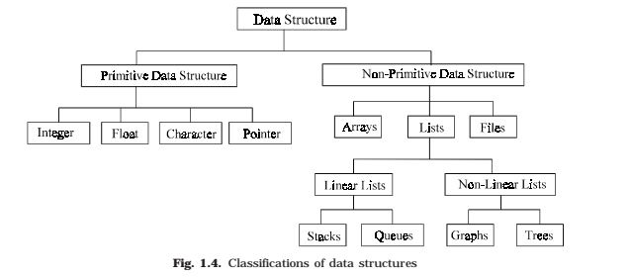

Slide 9
ALGORITHM
The word algorithm comes from the name of a renowned Persian mathematician Abu Ja’far Mohammed ibn-i Musa al khowarizmi.
Algorithm is a step-by-step finite sequence of instruction, to solve a well-defined computational problem.
An algorithm is a step-by-step procedure for solving a problem in a finite amount of time.
Input
Algorithm
Output

Slide 10
An algorithm is “a finite set of precise instructions for performing a computation or for solving a problem”
  A program is one type of algorithm
    All programs are algorithms
    Not all algorithms are programs!
  Directions to somebody’s house is an algorithm
  A recipe for cooking a cake is an algorithm
  The steps to compute the cosine of 90° is an algorithm

Slide 11
Expressing algorithms
An algorithm may be expressed in a number of ways, including:
Natural language: usually verbose and ambiguous.
Flow charts: using diagrams.
Pseudo-code: Informal language used to present algorithms. no particular agreement on syntax.
Programming language: Tend to require expressing low-level details that are not necessary for a high-level understanding.

Slide 12
What is a Flowchart?
START
Display message “How many hours did you work?”
A flowchart is a diagram that depicts the “flow” of a program.
The figure shown here is a flowchart for the pay-calculating program .
Read Hours
Display message “How much do you get paid per hour?”
Read Pay Rate
Multiply Hours by Pay Rate. Store result in Gross Pay.
Display Gross Pay
END

Slide 13
Basic Flowchart Symbols
START
Terminal
Display message “How many hours did you work?”
Terminals
  represented by rounded rectangles
  indicate a starting or ending point
Read Hours
Display message “How much do you get paid per hour?”
Read Pay Rate
Multiply Hours by Pay Rate. Store result in Gross Pay.
START
Display Gross Pay
END
Terminal
END

Slide 14
Basic Flowchart Symbols
START
Display message “How many hours did you work?”
Input/Output Operations
  represented by parallelograms
  indicate an input or output operation
Read Hours
Display message “How much do you get paid per hour?”
Input/Output Operation
Read Pay Rate
Multiply Hours by Pay Rate. Store result in Gross Pay.
Display message “How many hours did you work?”
Read Hours
Display Gross Pay
END

Slide 15
Basic Flowchart Symbols
START
Display message “How many hours did you work?”
Processes
  represented by rectangles
  indicates a process such as a mathematical computation or variable assignment
Read Hours
Display message “How much do you get paid per hour?”
Read Pay Rate
Multiply Hours by Pay Rate. Store result in Gross Pay.
Multiply Hours by Pay Rate. Store result in Gross Pay.
Process
Display Gross Pay
END

Slide 16
Basic Flowchart Symbols
START
Display message “How many hours did you work?”
Decision
  represented by Diamond
  A diamond indicates a decision
Read Hours
Display message “How much do you get paid per hour?”
Read Pay Rate
Multiply Hours by Pay Rate. Store result in Gross Pay.
Display Gross Pay
END

Slide 17
Four Flowchart Structures
Sequence
Decision
Repetition
Case

Slide 18
1. Sequence Structure
A series of actions are performed in sequence.
The pay-calculating example was a sequence flowchart.

Slide 19
2. Decision Structure
One of two possible actions is taken, depending on a condition.

Slide 20
Decision Structure
The diamond symbol indicates a yes/no question. If the answer to the question is yes, the flow follows one path. If the answer is no, the flow follows another path
NO
YES

Slide 21
Decision Structure
In the flowchart segment below, the question “is x < y?” is asked. If the answer is no, then process A is performed. If the answer is yes, then process B is performed.
NO
YES
x < y?
Process A
Process B

Slide 22
Decision Structure
The flowchart segment below shows how a decision structure is expressed in C++ as an if/else statement.
Flowchart
C++ Code
NO
YES
if (x < y)
a = x * 2;
else
a = x + y;
x < y?
Calculate a as x plus y.
Calculate a as x times 2.

Slide 23
Decision Structure
The flowchart segment below shows a decision structure with only one action to perform. It is expressed as an if statement in C++ code.
Flowchart
C++ Code
NO
YES
if (x < y)
a = x * 2;
x < y?
Calculate a as x times 2.

Slide 24
3. Repetition Structure
A repetition structure represents part of the program that repeats. This type of structure is commonly known as a loop.

Slide 25
Repetition Structure
Notice the use of the diamond symbol. A loop tests a condition, and if the condition exists, it performs an action. Then it tests the condition again. If the condition still exists, the action is repeated. This continues until the condition no longer exists.

Slide 26
Repetition Structure
In the flowchart segment, the question “is x < y?” is asked. If the answer is yes, then Process A is performed. The question “is x < y?” is asked again. Process A is repeated as long as x is less than y. When x is no longer less than y, the repetition stops and the structure is exited.
YES
x < y?
Process A

Slide 27
Repetition Structure
The flowchart segment below shows a repetition structure expressed in C++ as a while loop.
Flowchart
C++ Code
while (x < y)
x++;
YES
x < y?
Add 1 to x

Slide 28
Controlling a Repetition Structure
The action performed by a repetition structure must eventually cause the loop to terminate. Otherwise, an infinite loop is created.
In this flowchart segment, x is never changed. Once the loop starts, it will never end.
QUESTION: How can this
flowchart be modified so
it is no longer an infinite
loop?
YES
x < y?
Display x

Slide 29
Controlling a Repetition Structure
ANSWER: By adding an action within the repetition that changes the value of x.
YES
x < y?
Display x
Add 1 to x

Slide 30
A Pre-Test Repetition Structure
This type of structure is known as a pre-test repetition structure. The condition is tested BEFORE any actions are performed.
YES
x < y?
Display x
Add 1 to x

Slide 31
A Pre-Test Repetition Structure
In a pre-test repetition structure, if the condition does not exist, the loop will never begin.
YES
x < y?
Display x
Add 1 to x

Slide 32
A Post-Test Repetition Structure
This flowchart segment shows a post-test
repetition structure.
The condition is tested AFTER the actions
are performed.
A post-test repetition structure always
performs its actions at least once.
Display x
Add 1 to x
YES
x < y?

Slide 33
A Post-Test Repetition Structure
The flowchart segment below shows a post-test repetition structure expressed in C++ as a do-while loop.
C++ Code
Display x
do
{
cout << x << endl;
x++;
} while (x < y);
Flowchart
Add 1 to x
YES
x < y?

Slide 34
4. Case Structure
One of several possible actions is taken, depending on the contents of a variable.

Slide 35
Case Structure
The structure below indicates actions to perform depending on the value in years_employed.
CASE
years_employed
1
2
3
Other
bonus = 100
bonus = 200
bonus = 400
bonus = 800

Slide 36
Case Structure
If years_employed = 2, bonus is set to 200
If years_employed = 3, bonus is set to 400
If years_employed = 1, bonus is set to 100
If years_employed is any other value, bonus is set to 800
CASE
years_employed
1
2
3
Other
bonus = 100
bonus = 200
bonus = 400
bonus = 800

Slide 37
Combining Structures
Structures are commonly combined to create more complex algorithms.
The flowchart segment below combines a decision structure with a sequence structure.
YES
x < y?
Display x
Add 1 to x

Slide 38
Combining Structures
This flowchart segment
shows two decision
structures combined.
NO
YES
x > min?
Display “x is outside the limits.”
NO
YES
x < max?
Display “x is outside the limits.”
Display “x is within limits.”

Slide 39
Pseudocode
Informal language used to present algorithms.
Pretty close to English but precise enough for a computing agent to carry out.
High-level description of an algorithm
More structured than English prose
Less detailed than a program
Preferred notation for describing algorithms
Hides program design issues

Slide 40
Example: find max element of an array
Algorithm arrayMax(A, n)
Input array A of n integers
Output maximum element of A
currentMax ← A[0]
for i ← 1 to n − 1 do
if A[i] > currentMax then
currentMax ← A[i]
return currentMax

Slide 41
Pseudocode Details
Control flow
  if … then … [else …]
  while … do …
  repeat … until …
  for … do …
  Indentation replaces braces
Method declaration
  Algorithm method (arg [, arg…])
  Input …
  Output …
Method/Function call
  var.method (arg [, arg…])
Return value
  return expression
Expressions
  Assignment
  (like = in C++)
  Equality testing
  (like == in C++)
  n² Superscripts and other mathematical formatting allowed

Slide 42
Properties of algorithms
Algorithms generally share a set of properties:
  Input: what the algorithm takes in as input
  Output: what the algorithm produces as output
  Definiteness: the steps are defined precisely
  Correctness: should produce the correct output
  Finiteness: the steps required should be finite
  Effectiveness: each step must be able to be performed in a finite amount of time
  Generality: the algorithm should be applicable to all problems of a similar form

Slide 43
Algorithm Examples?
Problem 1: What is the largest integer
  INPUT: All the integers { … -2, -1, 0, 1, 2, … }
  OUTPUT: The largest integer
  Algorithm:
    Arrange all the integers in a list in decreasing order;
    MAX = first number in the list;
    Print out MAX;
  WHY is the above NOT an Algorithm?
    (Hint: How many integers are there?)
Problem 2: Who is the tallest women in the world?
  Algorithm:

Slide 44
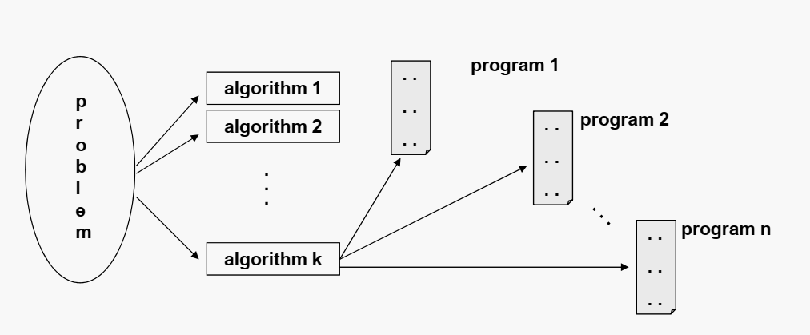
Problems vs Algorithms vs Programs
For each problem or class of problems, there may be many different algorithms.
For each algorithm, there may be many different implementations (programs).

Slide 45
Algorithmic Performance
There are two aspects of algorithmic performance:
1. Time
    Instructions take time.
    How fast does the algorithm perform?
    What affects its runtime?
2. Space
    Data structures take space
    What kind of data structures can be used?
    How does choice of data structure affect the runtime?

Slide 46
SPACE COMPLEXITY
Analysis of space complexity of an algorithm or program is the amount of memory it needs to run to completion.
Some of the reasons for studying space complexity are:
1. If the program is to run on multi user system, it may be required to specify the amount of memory to be allocated to the program.
2. We may be interested to know in advance that whether sufficient memory is available to run the program.
3. There may be several possible solutions with different space requirements.
4. Can be used to estimate the size of the largest problem that a program can solve

Slide 47
TIME COMPLEXITY
The time complexity of an algorithm or a program is the amount of time it needs to run to completion.
The exact time will depend on the implementation of the algorithm, programming language, optimizing the capabilities of the compiler used, the CPU speed,
other hardware characteristics/specifications and so on.
To measure the time complexity accurately, we have to count all sorts of operations performed in an algorithm. If we know the time for each one of the primitive operations performed in a given computer, we can easily compute the time taken by an algorithm to complete its execution.

Slide 48
Our intention is to estimate the execution time of an algorithm irrespective of the computer machine on which it will be used.
The more sophisticated method is to identify the key operations and count such operations performed till the program completes its execution.
A key operation in our algorithm is an operation that takes maximum time among all possible operations in the algorithm.
The time complexity can now be expressed as function of number of key operations performed.

Slide 49
Worst-Case/ Best-Case/ Average-Case Analysis
Worst-Case Analysis –The maximum amount of time that an algorithm require to solve a problem of size n. This gives an upper bound for the time complexity of an algorithm.
Best-Case Analysis –The minimum amount of time that an algorithm require to solve a problem of size n. The best case behavior of an algorithm is NOT so useful.
Average-Case Analysis –The average amount of time that an algorithm require to solve a problem of size n. Sometimes, it is difficult to find the average-case behavior of an algorithm.
  Worst-case analysis is more common than average-case analysis.

Slide 50
TIME-SPACE TRADE OFF
There may be more than one approach (or algorithm) to solve a problem. The best
algorithm (or program) to solve a given problem is one that requires less space in memory and takes less time to complete its execution. But in practice, it is not always possible to achieve both of these objectives. One algorithm may require more space but less time to complete its execution while the other algorithm requires less space but takes more time to complete its execution. Thus, we may have to sacrifice one at the cost of the other. If the space is our constraint, then we have to choose a program that requires less space at the cost of more execution time. On the other hand, if time is our constraint such as in real time system, we have to choose a program that takes less time to complete its execution at the cost of more space.

Slide 51
ANALYSIS OF ALGORITHM
After designing an algorithm we have to make analysis for two reasons,
It has to be checked and its correctness needs to be predicted; this is done by
  Analyzing the algorithm.
  Tracing all step-by-step instructions,
  Reading the algorithm for logical correctness, and
  Testing it on some data using mathematical techniques to prove it correct.
2 ) To know the simplicity of the algorithm (performance analysis in terms of time and space)
Characterizes running time as a function of the input size, n.
Takes into account all possible inputs
Allows us to evaluate the speed of an algorithm independent of the hardware/software environment

Slide 52
When we analyze algorithms, we should employ mathematical techniques that analyze algorithms independently of specific implementations, computers, or data.
To analyze algorithms:
  First, we start to count the number of significant /basic / primitive operations in a particular solution to assess its efficiency.
  Then, we will express the efficiency of algorithms using growth functions.

Slide 53
Primitive Operations
Examples:
  Evaluating an expression
  Assigning a value to a variable
  Indexing into an array
  Calling a method
  Returning from a method
Basic computations performed by an algorithm
Identifiable in pseudocode
Largely independent from the programming language
Exact definition not important
Assumed to take a constant amount of time in the RAM model

Slide 54
General Rules for Estimation
We assume an arbitrary time unit.
Execution of one of the following operations takes time 1:
  Assignment operation
  Single I/O operations
  Single Boolean operations, numeric comparisons
  Single arithmetic operations
  Function return
  Array index operations, pointer dereferences

Slide 55
More Rules
Running time of a selection statement (if, switch) is the time for the condition evaluation + the maximum of the running times for the individual clauses in the selection.
Loop execution time is the sum, over the number of times the loop is executed, of the body time + time for the loop check and update operations + time for the loop setup.
  Always assume that the loop executes the maximum number of iterations possible
Running time of a function call is 1 for setup + the time for any parameter calculations + the time required for the execution of the function body.

Slide 56
Counting Primitive Operations
By inspecting the pseudocode, we can determine the maximum number of primitive operations executed by an algorithm, as a function of the input size
Time Units to Compute
-------------------------------------------------
1 for the assignment statement: int k=0
1 for the output statement.
1 for the input statement.
In the for loop:
1 assignment, n+1 tests and n increments.
n loops of 2 units for an assignment and an addition.
1 for the return statement.
-------------------------------------------------------------------
T (n)= 1+1+1+(1+n+1+n)+2n+1 = 4n+6 = O(n)
Examples:
int count()
{
int k=0;
cout<< “Enter an integer”;
cin>>n;
for (i=0;i<n;i++)
k=k+1;
return 0;
}

Slide 57
Time Units to Compute
-------------------------------------------------
1 for the assignment statement: int sum=0
In the for loop:
1 assignment, n+1 tests, and n increments.
n loops of 2 units for an assignment, and an addition.
1 for the return statement.
-------------------------------------------------------------------
T (n)= 1+ (1+n+1+n)+2n+1 = 4n+4 = O(n)
int total(int n)
{
int sum=0;
for (int i=1;i<=n;i++)
sum=sum+1;
return sum;
}

Slide 58
Time Units to Compute
-------------------------------------------------
1 for the first assignment statement: x=0;
1 for the second assignment statement: i=0;
1 for the third assignment statement: j=1;
1 for the output statement.
1 for the input statement.
In the first while loop:
n+1 tests
n loops of 2 units for the two increment (addition) operations
In the second while loop:
n tests
n-1 increments
-------------------------------------------------------------------
T (n)= 1+1+1+1+1+n+1+2n+n+n-1 = 5n+5 = O(n)
void func()
{
int x=0;
int i=0;
int j=1;
cout<< “Enter an Integer value”;
cin>>n;
while (i<n)
{
x++;
i++;
}
while (j<n)
{
j++;
}
}

Slide 59
int sum (int n)
{
int partial_sum = 0;
for (int i = 1; i <= n; i++)
partial_sum = partial_sum +(i * i * i);
return partial_sum;
}
Time Units to Compute
-------------------------------------------------
1 for the assignment.
1 assignment, n+1 tests, and n increments.
n loops of 4 units for an assignment, an addition, and two multiplications.
1 for the return statement.
-------------------------------------------------------------------
T (n)= 1+(1+n+1+n)+4n+1 = 6n+4 = O(n)

Slide 60
Each operation in an algorithm (or a program) has a cost.
➔ Each operation takes a certain of time.
count = count + 1; ➔ take a certain amount of time, but it is constant
A sequence of operations:
count = count + 1; Cost: c₁
sum = sum + count; Cost: c₂
➔ Total Cost = c₁ + c₂

Slide 61
Example: Simple If-Statement
Cost Times
if (n < 0) c1 1
absval = -n c2 1
else
absval = n; c3 1
Total Cost <= c1 + max(c2,c3)

Slide 62
Example: Simple Loop
Cost Times
i = 1; c1 1
sum = 0; c2 1
while (i <= n) { c3 n+1
i = i + 1; c4 n
sum = sum + i; c5 n
}
Total Cost = c1 + c2 + (n+1)*c3 + n*c4 + n*c5
➔ The time required for this algorithm is proportional to n

Slide 63
Example: Nested Loop
Cost Times
i=1; c1 1
sum = 0; c2 1
while (i <= n) { c3 n+1
j=1; c4 n
while (j <= n) { c5 n*(n+1)
sum = sum + i; c6 n*n
j = j + 1; c7 n*n
}
i = i +1; c8 n
}
Total Cost = c1 + c2 + (n+1)*c3 + n*c4 + n*(n+1)*c5+n*n*c6+n*n*c7+n*c8
➔ The time required for this algorithm is proportional to n²

Slide 64
Growth-Rate Functions
O(1) Time requirement is constant, and it is independent of the problem’s size.
O(log₂n) Time requirement for a logarithmic algorithm increases slowly as the problem size increases.
O(n) Time requirement for a linear algorithm increases directly with the size of
the problem.
O(n*log₂n) Time requirement for a n*log₂n algorithm increases more rapidly than a linear algorithm.
O(n²) Time requirement for a quadratic algorithm increases rapidly with the
size of the problem.
O(n³) Time requirement for a cubic algorithm increases more rapidly with the
size of the problem than the time requirement for a quadratic algorithm.
O(2^{n}) As the size of the problem increases, the time requirement for an
exponential algorithm increases too rapidly to be practical.

Slide 65
Growth-Rate Functions
If an algorithm takes 1 second to run with the problem size 8, what is the time requirement (approximately) for that algorithm with the problem size 16?
If its order is:
O(1) ➔ T(n) = 1 second
O(log₂n) ➔ T(n) = (1*log₂16) / log₂8 = 4/3 seconds
O(n) ➔ T(n) = (1*16) / 8 = 2 seconds
O(n*log₂n) ➔ T(n) = (1*16*log₂16) / 8*log₂8 = 8/3 seconds
O(n²) ➔ T(n) = (1*16²) / 8² = 4 seconds
O(n³) ➔ T(n) = (1*16³) / 8³ = 8 seconds
O(2^{n}) ➔ T(n) = (1*2¹⁶) / 2⁸ = 2⁸ seconds = 256 seconds

Slide 66
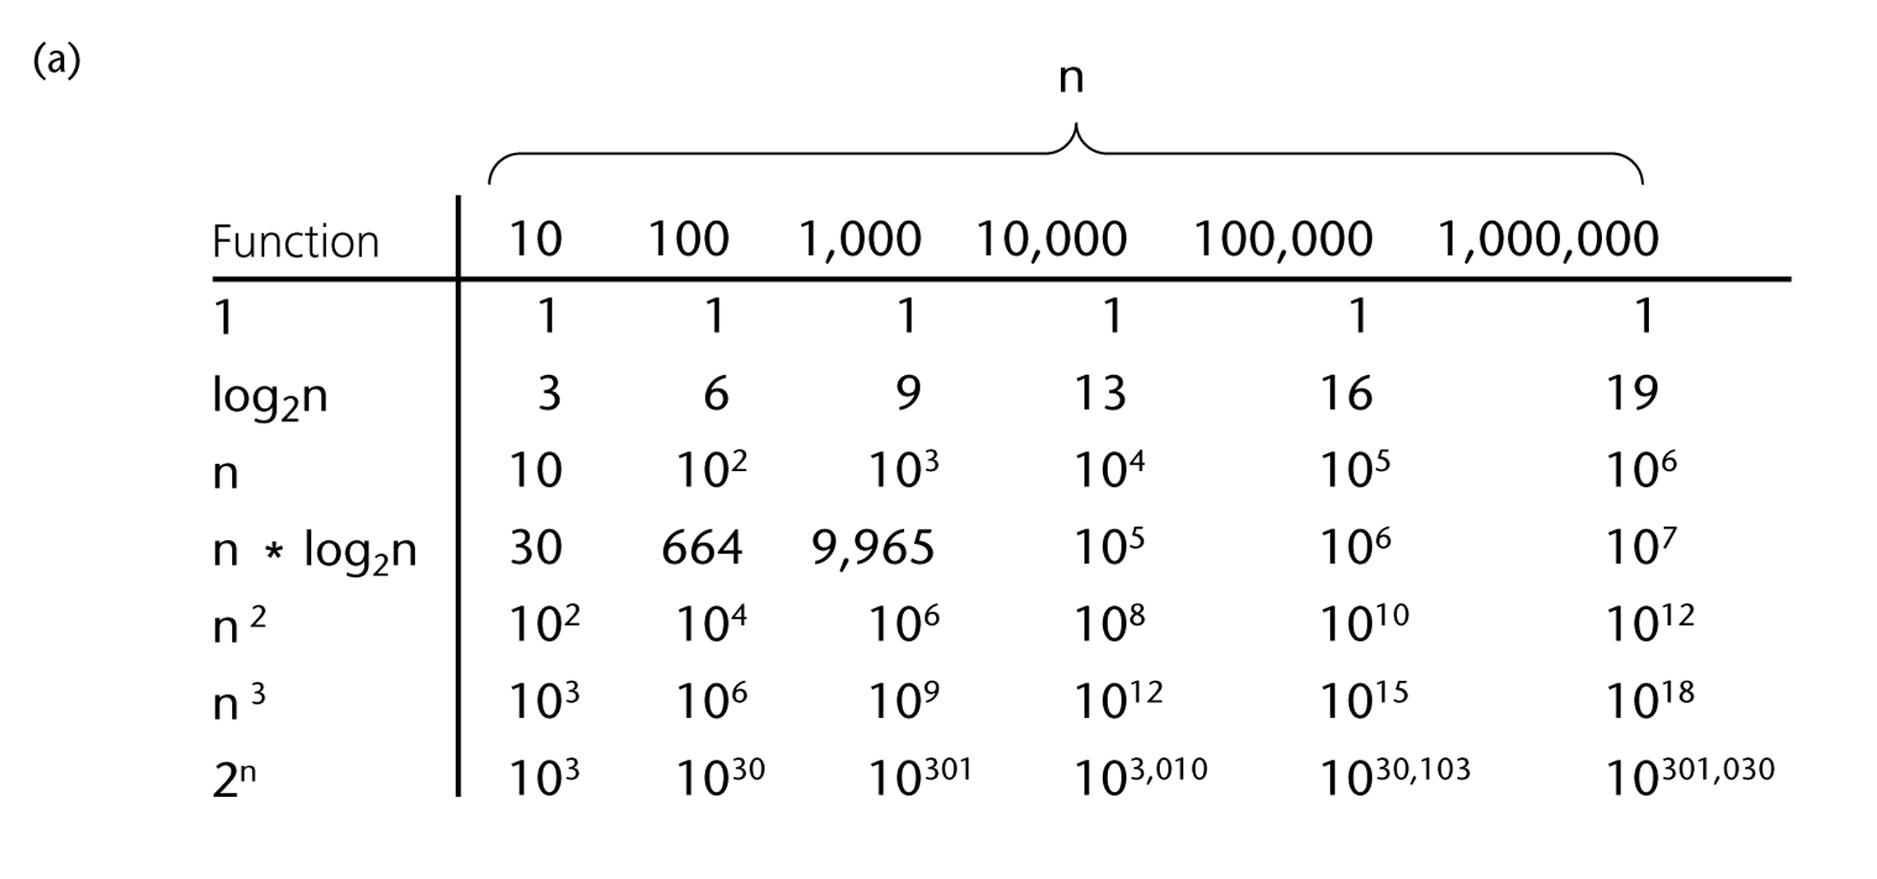
A Comparison of Growth-Rate Functions

Slide 67
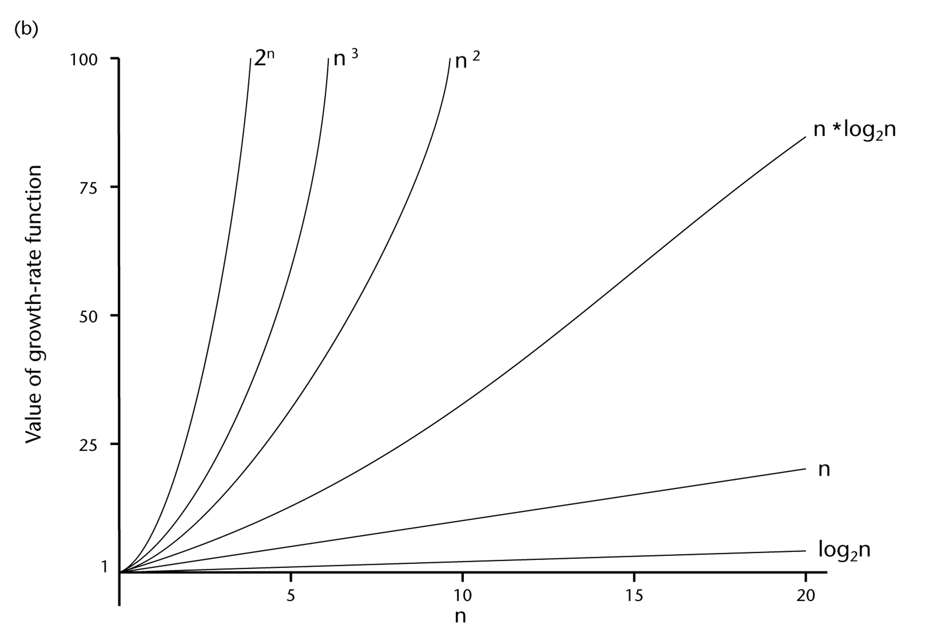
A Comparison of Growth-Rate Functions (cont.)

Slide 68
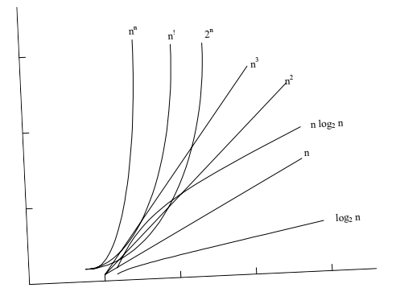

Slide 69
Properties of Growth-Rate Functions
We can ignore low-order terms in an algorithm’s growth-rate function.
  If an algorithm is O(n³+4n²+3n), it is also O(n³).
  We only use the higher-order term as algorithm’s growth-rate function.
We can ignore a multiplicative constant in the higher-order term of an algorithm’s growth-rate function.
  If an algorithm is O(5n³), it is also O(n³).
O(f(n)) + O(g(n)) = O(f(n)+g(n))
  We can combine growth-rate functions.
  If an algorithm is O(n³) + O(4n²), it is also O(n³ +4n²) ➔ So, it is O(n³).
  Similar rules hold for multiplication.

Slide 70
Some Mathematical Facts
Some mathematical equalities are:

Slide 71
Growth-Rate Functions – Example1
Cost Times
i = 1; c1 1
sum = 0; c2 1
while (i <= n) { c3 n+1
i = i + 1; c4 n
sum = sum + i; c5 n
}
T(n) = c1 + c2 + (n+1)*c3 + n*c4 + n*c5
= (c3+c4+c5)*n + (c1+c2+c3)
= a*n + b
➔ So, the growth-rate function for this algorithm is O(n)

Slide 72
Growth-Rate Functions – Example2
Cost Times
i=1; c1 1
sum = 0; c2 1
while (i <= n) { c3 n+1
j=1; c4 n
while (j <= n) { c5 n*(n+1)
sum = sum + i; c6 n*n
j = j + 1; c7 n*n
}
i = i +1; c8 n
}
T(n) = c1 + c2 + (n+1)*c3 + n*c4 + n*(n+1)*c5+n*n*c6+n*n*c7+n*c8
= (c5+c6+c7)*n² + (c3+c4+c5+c8)*n + (c1+c2+c3)
= a*n² + b*n + c
➔ So, the growth-rate function for this algorithm is O(n²)

Slide 73
Growth-Rate Functions – Example3
Cost Times
for (i=1; i<=n; i++) c1 n+1
for (j=1; j<=i; j++) c2
for (k=1; k<=j; k++) c3
x=x+1; c4
T(n) = c1*(n+1) + c2*( ) + c3* ( ) + c4*( )
= a*n³ + b*n² + c*n + d
➔ So, the growth-rate function for this algorithm is O(n³)

Slide 74
Asymptotic Notation
        The notation we use to describe the asymptotic running time of an algorithm are defined in terms of functions whose domains are the set of natural numbers
  Three types
  “Big O” Notation O()
  “Big Omega” Notation Ω()
  “Big Theta” Notation Θ()

Slide 75
Big-O notation
For a given function , we denote by the set of functions
We use O-notation to give an asymptotic upper bound of a function, to within a constant factor.
means that there existes some constant c s.t. is always for large enough n.

Slide 76
Big- Ω Omega notation
For a given function , we denote by the set of functions
We use Ω-notation to give an asymptotic lower bound on a function, to within a constant factor.
means that there exists some constant c s.t.
is always for large enough n.

Slide 77
Big- Theta notation
For a given function , we denote by the set of functions
A function belongs to the set if there exist positive constants and such that it can be “sand- wiched” between and or sufficienly large n.
means that there exists some constant c₁ and c₂ s.t. for large enough n.

Slide 78
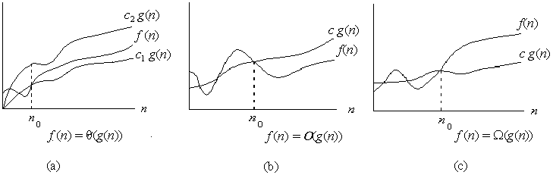
Asymptotic notation
Graphic examples of and .

Slide 79
1. f(n)=10n+5 and g(n)=n. Show that f(n) is O(g(n)).
To show that f(n) is O(g(n)) we must show that constants c and no such that
f(n) <=c.g(n) for all n>=no
Or 10n+5<=c.n for all n>=no
Try c=15. Then we need to show that 10n+5<=15n
Solving for n we get: 5<=5n or 1<=n.
So f(n) =10n+5 <=15.g(n) for all n>=1.
(c=15,no=1).

Slide 80
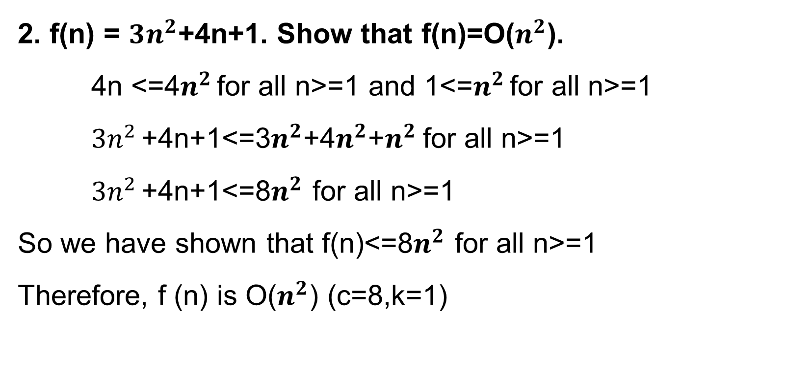
2. f(n) = ${3n}^{2}$+4n+1. Show that f(n)=O($n^{2}$).
4n <=4$n^{2}$ for all n>=1 and 1<=$n^{2}$ for all n>=1
${3n}^{2}$ +4n+1<=3$n^{2}$+4$n^{2}$+$n^{2}$ for all n>=1
${3n}^{2}$ +4n+1<=8$n^{2}$ for all n>=1
So we have shown that f(n)<=8$n^{2}$ for all n>=1
Therefore, f (n) is O($n^{2}$) (c=8,k=1)

Slide 81
Example 1.
Show that
We must find c₁ and c₂ such that
Dividing bothsides by n² yields
For

Slide 82
Theorem
For any two functions and , we have
if and only if

Slide 83
Example 2.
Because :

Slide 84
Example 3.

Slide 85
Standard notations and common functions
Floors and ceilings

Slide 86
Standard notations and common functions
Logarithms:

Slide 87
Standard notations and common functions
Logarithms:
For all real a>0, b>0, c>0, and n

Slide 88
Standard notations and common functions
Logarithms:

Slide 89
Standard notations and common functions
Factorials
For the Stirling approximation:

Slide 90
Examples
f(n)= 3n² + 17
Ω(1), Ω(n), Ω(n²) ➔ lower bounds
O(n²), O(n³), ... ➔ upper bounds
Θ(n²) ➔ exact bound

Slide 91
Typical Growth Rates
Function Name
f(x) = c, c ∈ R | Constant
log(N) | Logarithmic
log²(N) | Log-squared
N | Linear
N log(N)
N² | Quadratic
N³ | Cubic
2^{N} | Exponential

Slide 92
Some Rules of Thumb
If f(n) is a polynomial of degree k
  Then f(n) = Θ(N^{k})
log^{k}N = O(N), for any k
  Logarithms grow very slowly compared to even linear growth

Slide 93
Exercise
f(N) = N logN and g(N) = N ^{1.5}
  Which one grows faster??
Note that g(N) = N ^{1.5} = N•N ^{0.5}
  Hence, between f(N) and g(N), we only need to compare growth rate of log(N) and N ^{0.5}
  Equivalently, we can compare growth rate of log²N with N
  Now, we can refer to the previously state result to figure out whether f(N) or g(N) grows faster!

Slide 94
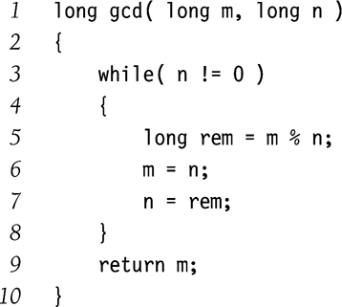
Euclid’s Algorithm
Find the greatest common divisor (gcd) between m and n
  Given that m ≥ n
Complexity = O(log(N))
Exercise:
  Why is it O(log(N)) ?

Slide 95
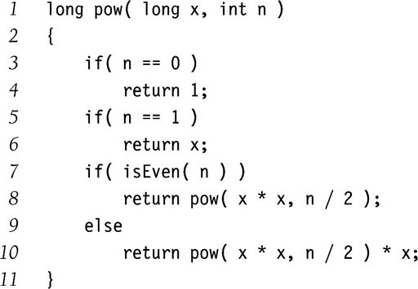
Exponentiation
Calculate x^{n}
Example:
  x¹¹ = x⁵ * x⁵ * x
  x⁵ = x² * x² * x
  x² = x * x
Complexity = O( logN )
Why didn’t we implement the recursion as follows?
  pow(x,n/2)*pow(x,n/2)*x

Slide 96
More Big-Oh Examples
7n-2
  7n-2 is O(n)
  need c > 0 and n₀ ≥ 1 such that 7n-2 ≤ c•n for n ≥ n₀
  this is true for c = 7 and n₀ = 1
3n³ + 20n² + 5
  3n³ + 20n² + 5 is O(n³)
  need c > 0 and n₀ ≥ 1 such that 3n³ + 20n² + 5 ≤ c•n³ for n ≥ n₀
  this is true for c = 4 and n₀ = 21
3 log n + log log n
  3 log n + log log n is O(log n)
  need c > 0 and n₀ ≥ 1 such that 3 log n + log log n ≤ c•log n for n ≥ n₀
  this is true for c = 4 and n₀ = 2

Slide 97
Big-Oh Rules
If is f(n) a polynomial of degree d, then f(n) is O(n^{d}), i.e.,
  Drop lower-order terms
  Drop constant factors
Use the smallest possible class of functions
  Say “2n is O(n)” instead of “2n is O(n²)”
Use the simplest expression of the class
  Say “3n + 5 is O(n)” instead of “3n + 5 is O(3n)”

Slide 98
THE END

